Slide 1
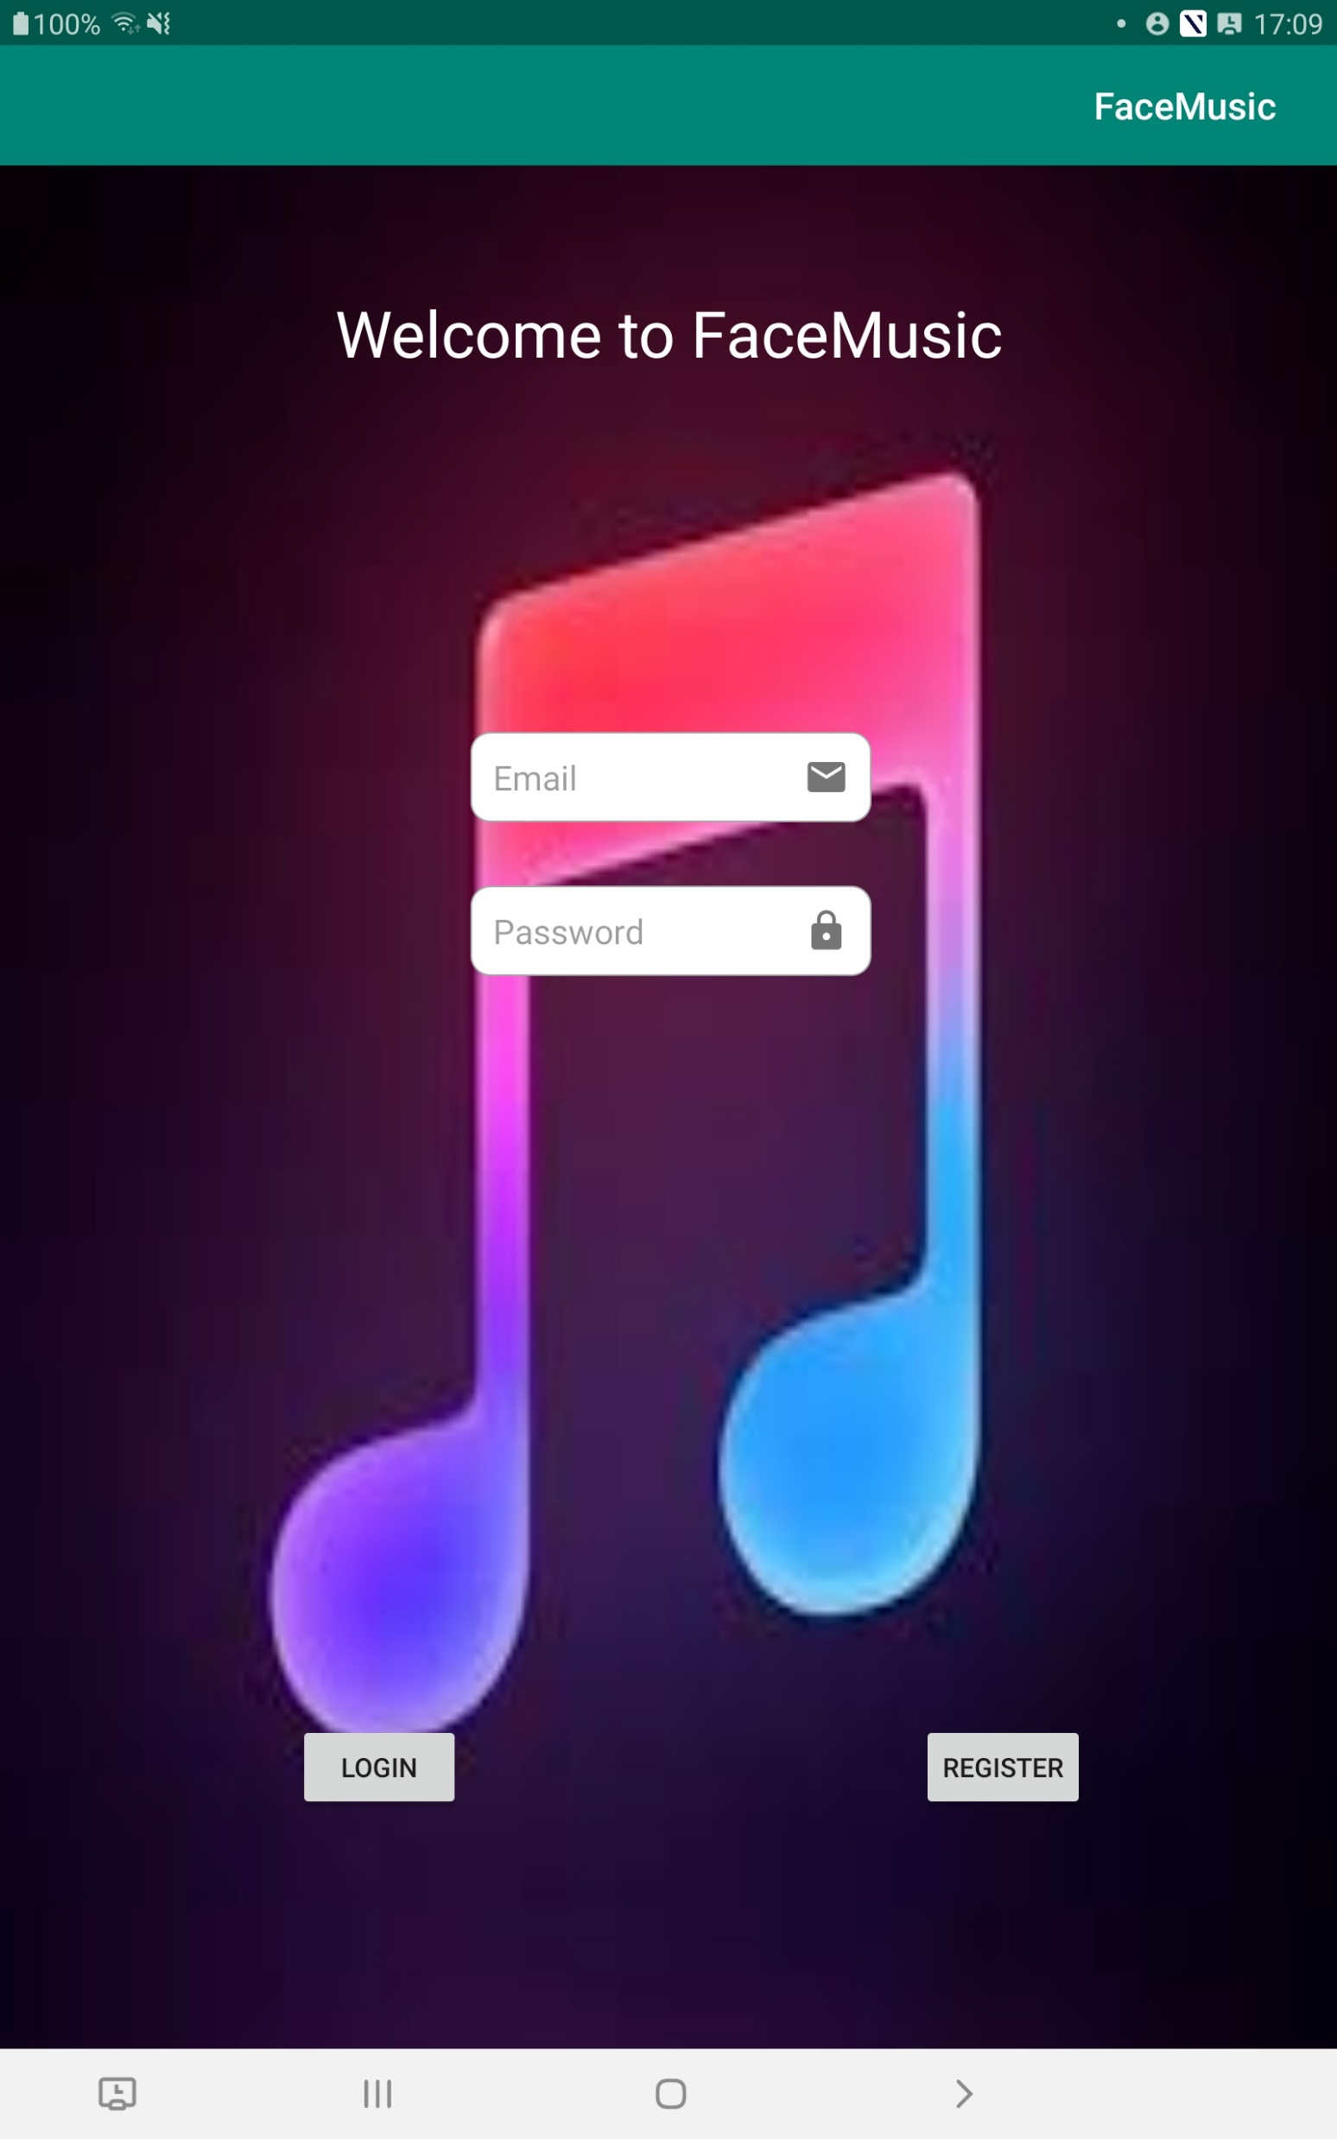
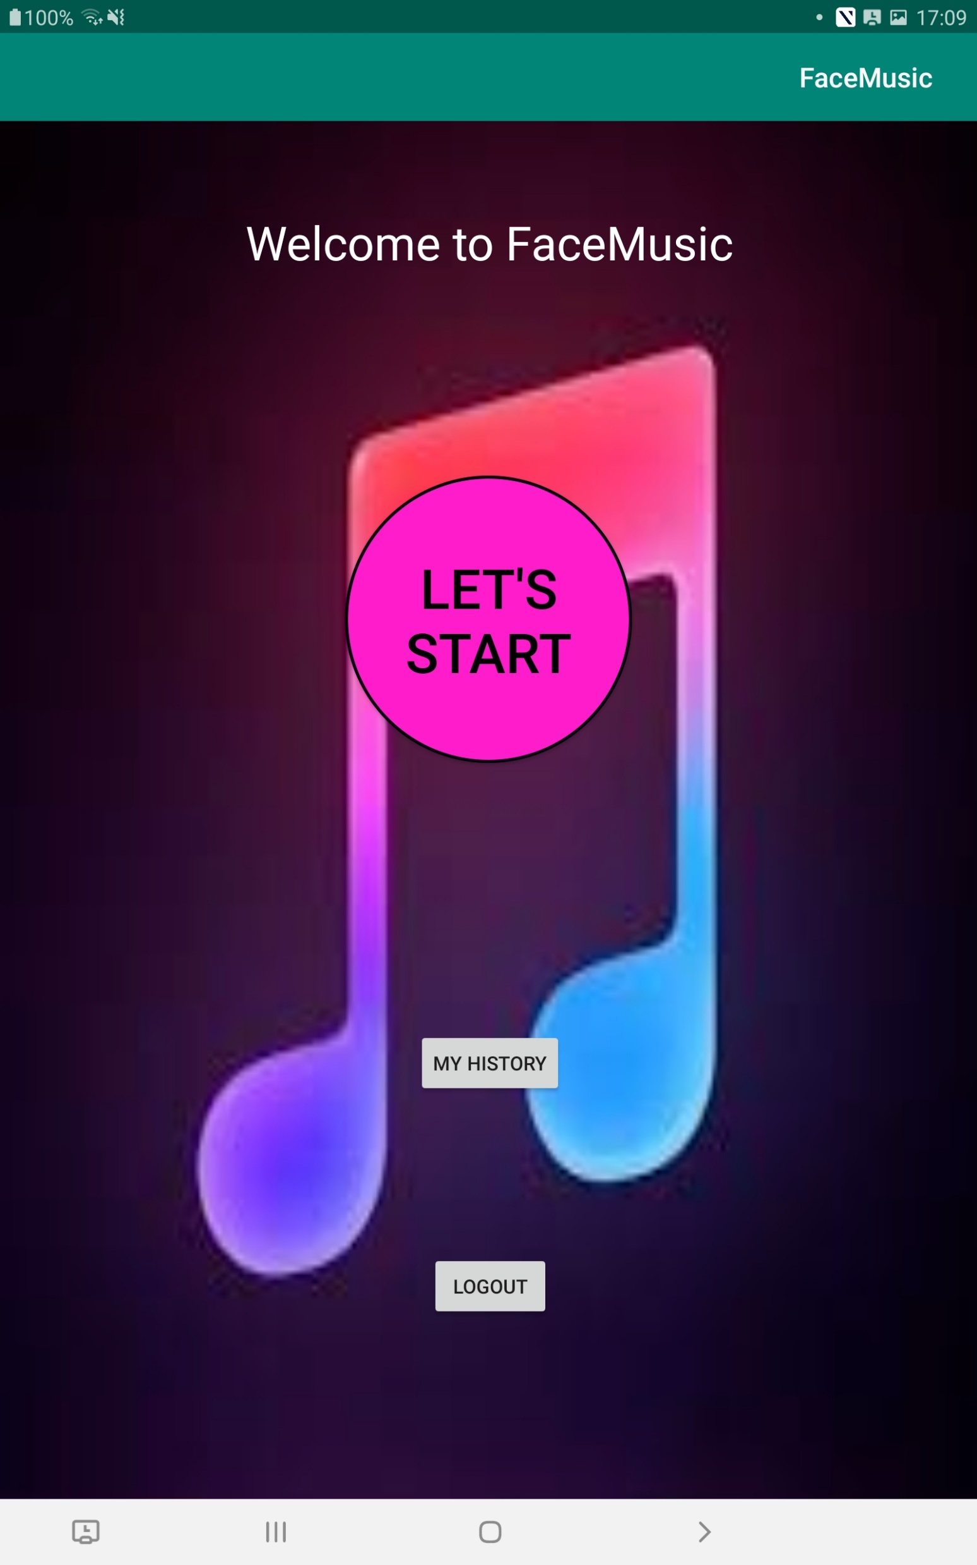
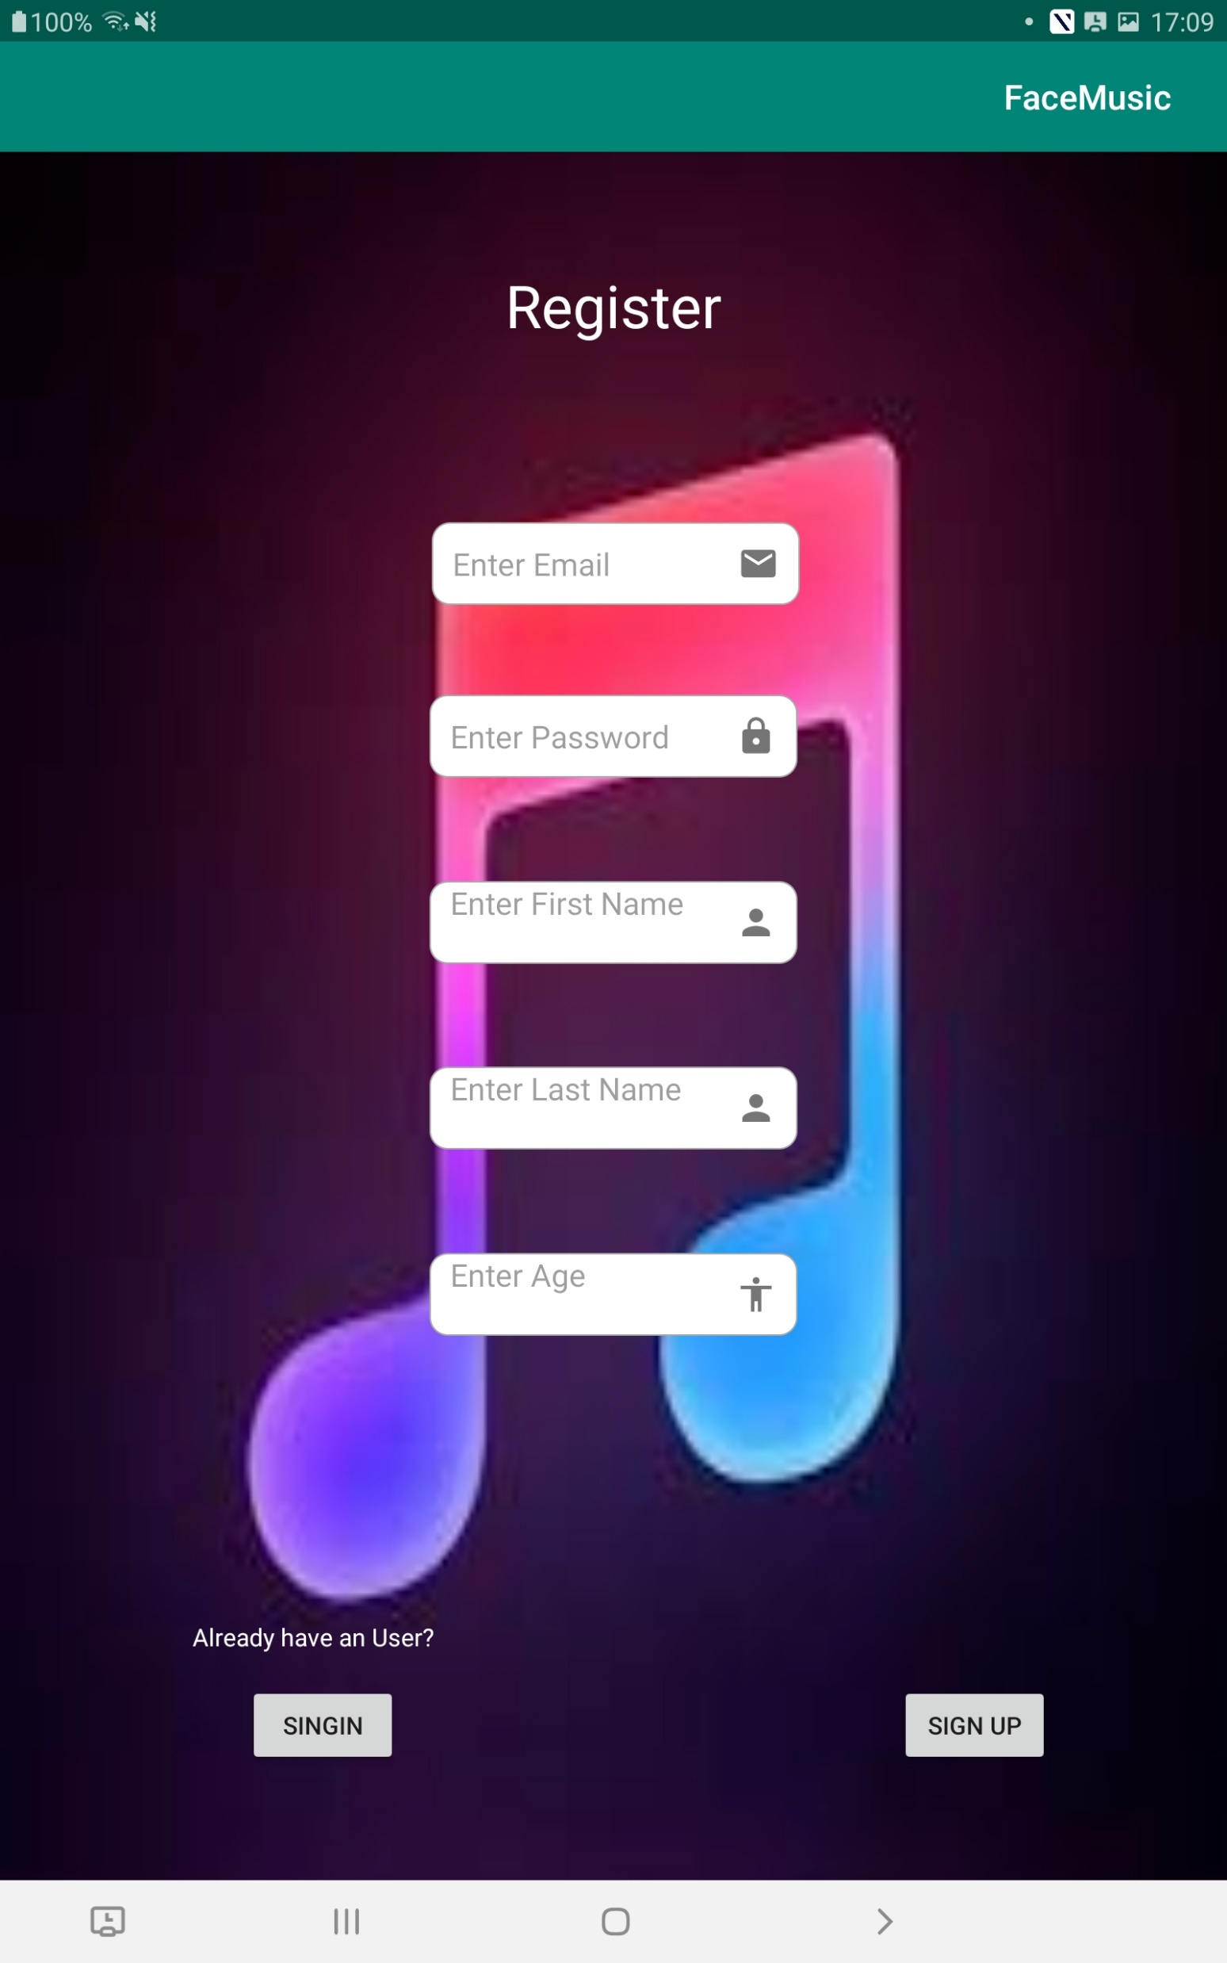
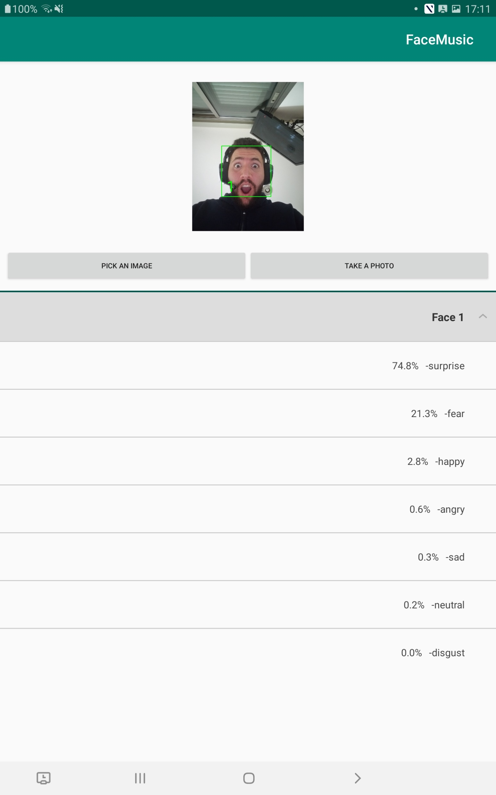
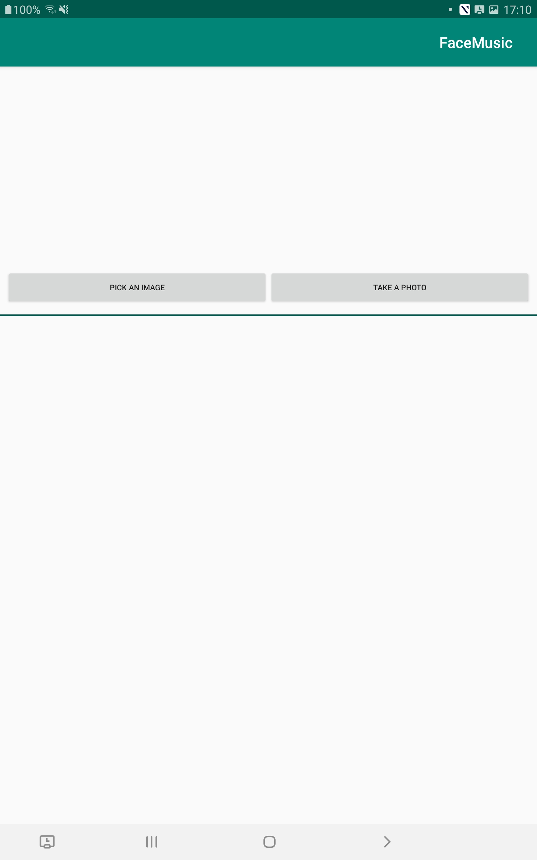
Register(“registerOnClick”)
LogOut(“logoutOnClick”)
SignIn(“loginOnClick”)
Let’s Start(“faceRecOnClick”)
SignIn(“ReturnToLoginScreenOnClick”)
Take a Photo(“onActivityResult”)

